Slide 1

Balancing to Takt Time in a Non-Manufacturing Setting
2019 Lean Summit – August 9, 2019
Anne Frewin, Sr Lean Operations Manager

Slide 2


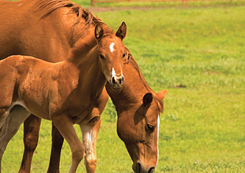
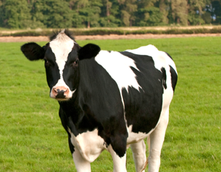
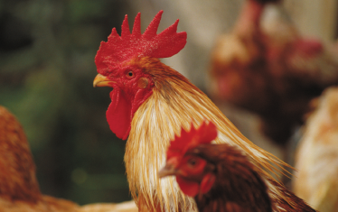

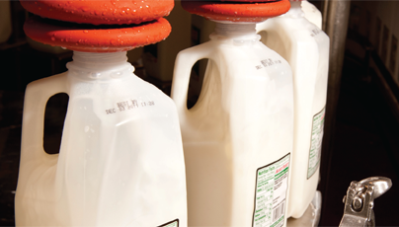
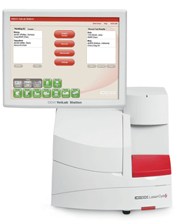
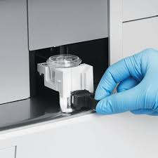
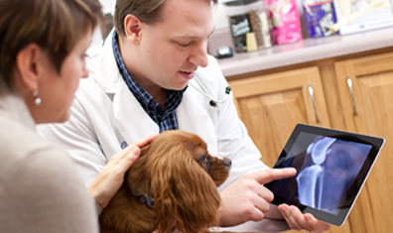
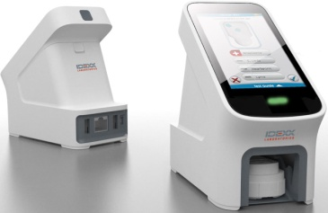
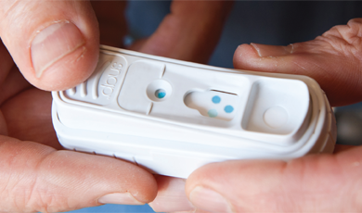
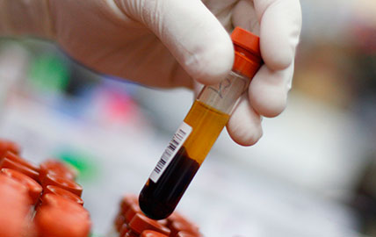
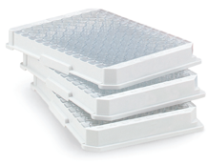
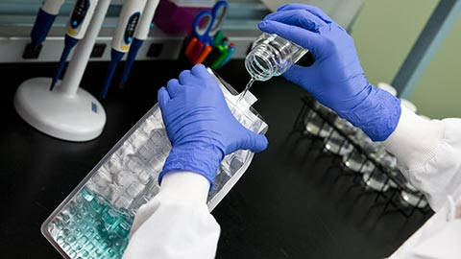
What Does do?
Water
Reference Labs
R&D
Manufacturing
Livestock, Poultry, Dairy
Notes:
IDEXX Designs and manufactures diagnostic tests and support services for Veterinary practices, Dairy Processors and Water Treatment plants.
IDEXX has a complex and diverse Customer base as well as a strong portfolio of products that rely on a complex mixture of engineering and scientific disciplines.
IDEXX has manufacturing, service and distribution centers across the world to support a global market.
When IDEXX began its Lean and Six Sigma journey in 2004 it was a $650M company, today, fourteen years later it is a $2B+ company. This growth has provided a fertile and culturally diverse environment in which to develop and refine the approaches for a successful Lean and Six Sigma program.

Slide 3
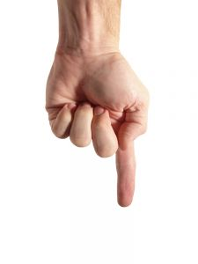
Lean Culture at IDEXX
Increase velocity and capacity
Reduce Waste
Notes:
If the work we’re doing don’t reduce waste, and doesn’t increase velocity and capacity, and doesn’t center around people we’re not doing lean. This is the essence of lean – a simple way to look at it.
What does velocity mean in your department?
Why do we need to create capacity?

Slide 4
Lean Organization
Culture
Tools
Strategy
Culture -
Continuous Improvement (PDSA)
Respect for Individual
Discipline to Standards
Intolerance of Waste
Reflection
Strategy -
Goals and Objectives
People, Quality, Delivery, Cost
Value Streams
Tools:
Gemba boards, 5S, RIP, Process Map,
Spaghetti diagram, Balance to takt
Notes:
Lean organizations have strong lean cultures, goals and objectives are aligned and focus is on the value stream, and tools are employed as needed. A lean culture is one of continuous improvement, respect for the individual – each person is valued and is empowered to make improvements, an intolerance of waste throughout the organization, and one in which people reflect on what’s working, what's not working, what could be better. Implementing tools without a lean culture leads to false starts and frustration. Implementing a culture without tools creates discouragement and confusion – there’s a desire to change but no method with which to make the change happen. Culture, strategy, and tools need to be employed together and with appropriate balance.

Slide 5
WHAT A LEAN CULTURE LOOKS LIKE
Continuous Improvement
Team meets daily to review the day
Team identifies and reduces waste in processes
Cycle times decrease
Capacity increases
New challenges arise
Employee Engagement
Financial Growth
Kaizens
RIEs
RIEs
Balance to takt
Quality, Safety
Productivity

Slide 6

PARASITOLOGY (O&P)

Slide 7
Our Project Process
PLAN:
Time Studies and Value Stream Maps
Rapid Improvement Project – identify and eliminate waste
DO:
Implementation phase (Study/Adjust)
STUDY/ACT:
Collaboration calls with other labs
Spread to 3 more labs
Spread to rest of the labs
PLAN
STUDY
ACT
DO

Slide 8
Key things to know
Samples are delivered to the lab in batches of hundreds at inconsistent phases over 3-5 hours (sometimes more)
Orders are entered then samples are delivered to the department in batches of 10 – 50+
All work is expected to be done by the end of the night (8am)
Samples are waiting when staff come in
We started with 4 labs then spread to 3 more
One person was doing the entire process and running multiple loads at a time
Processing loads of 20 samples at a time

Slide 9

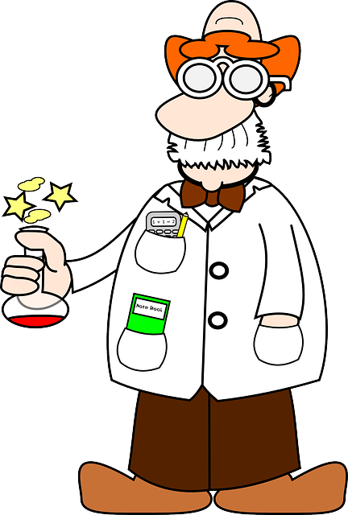
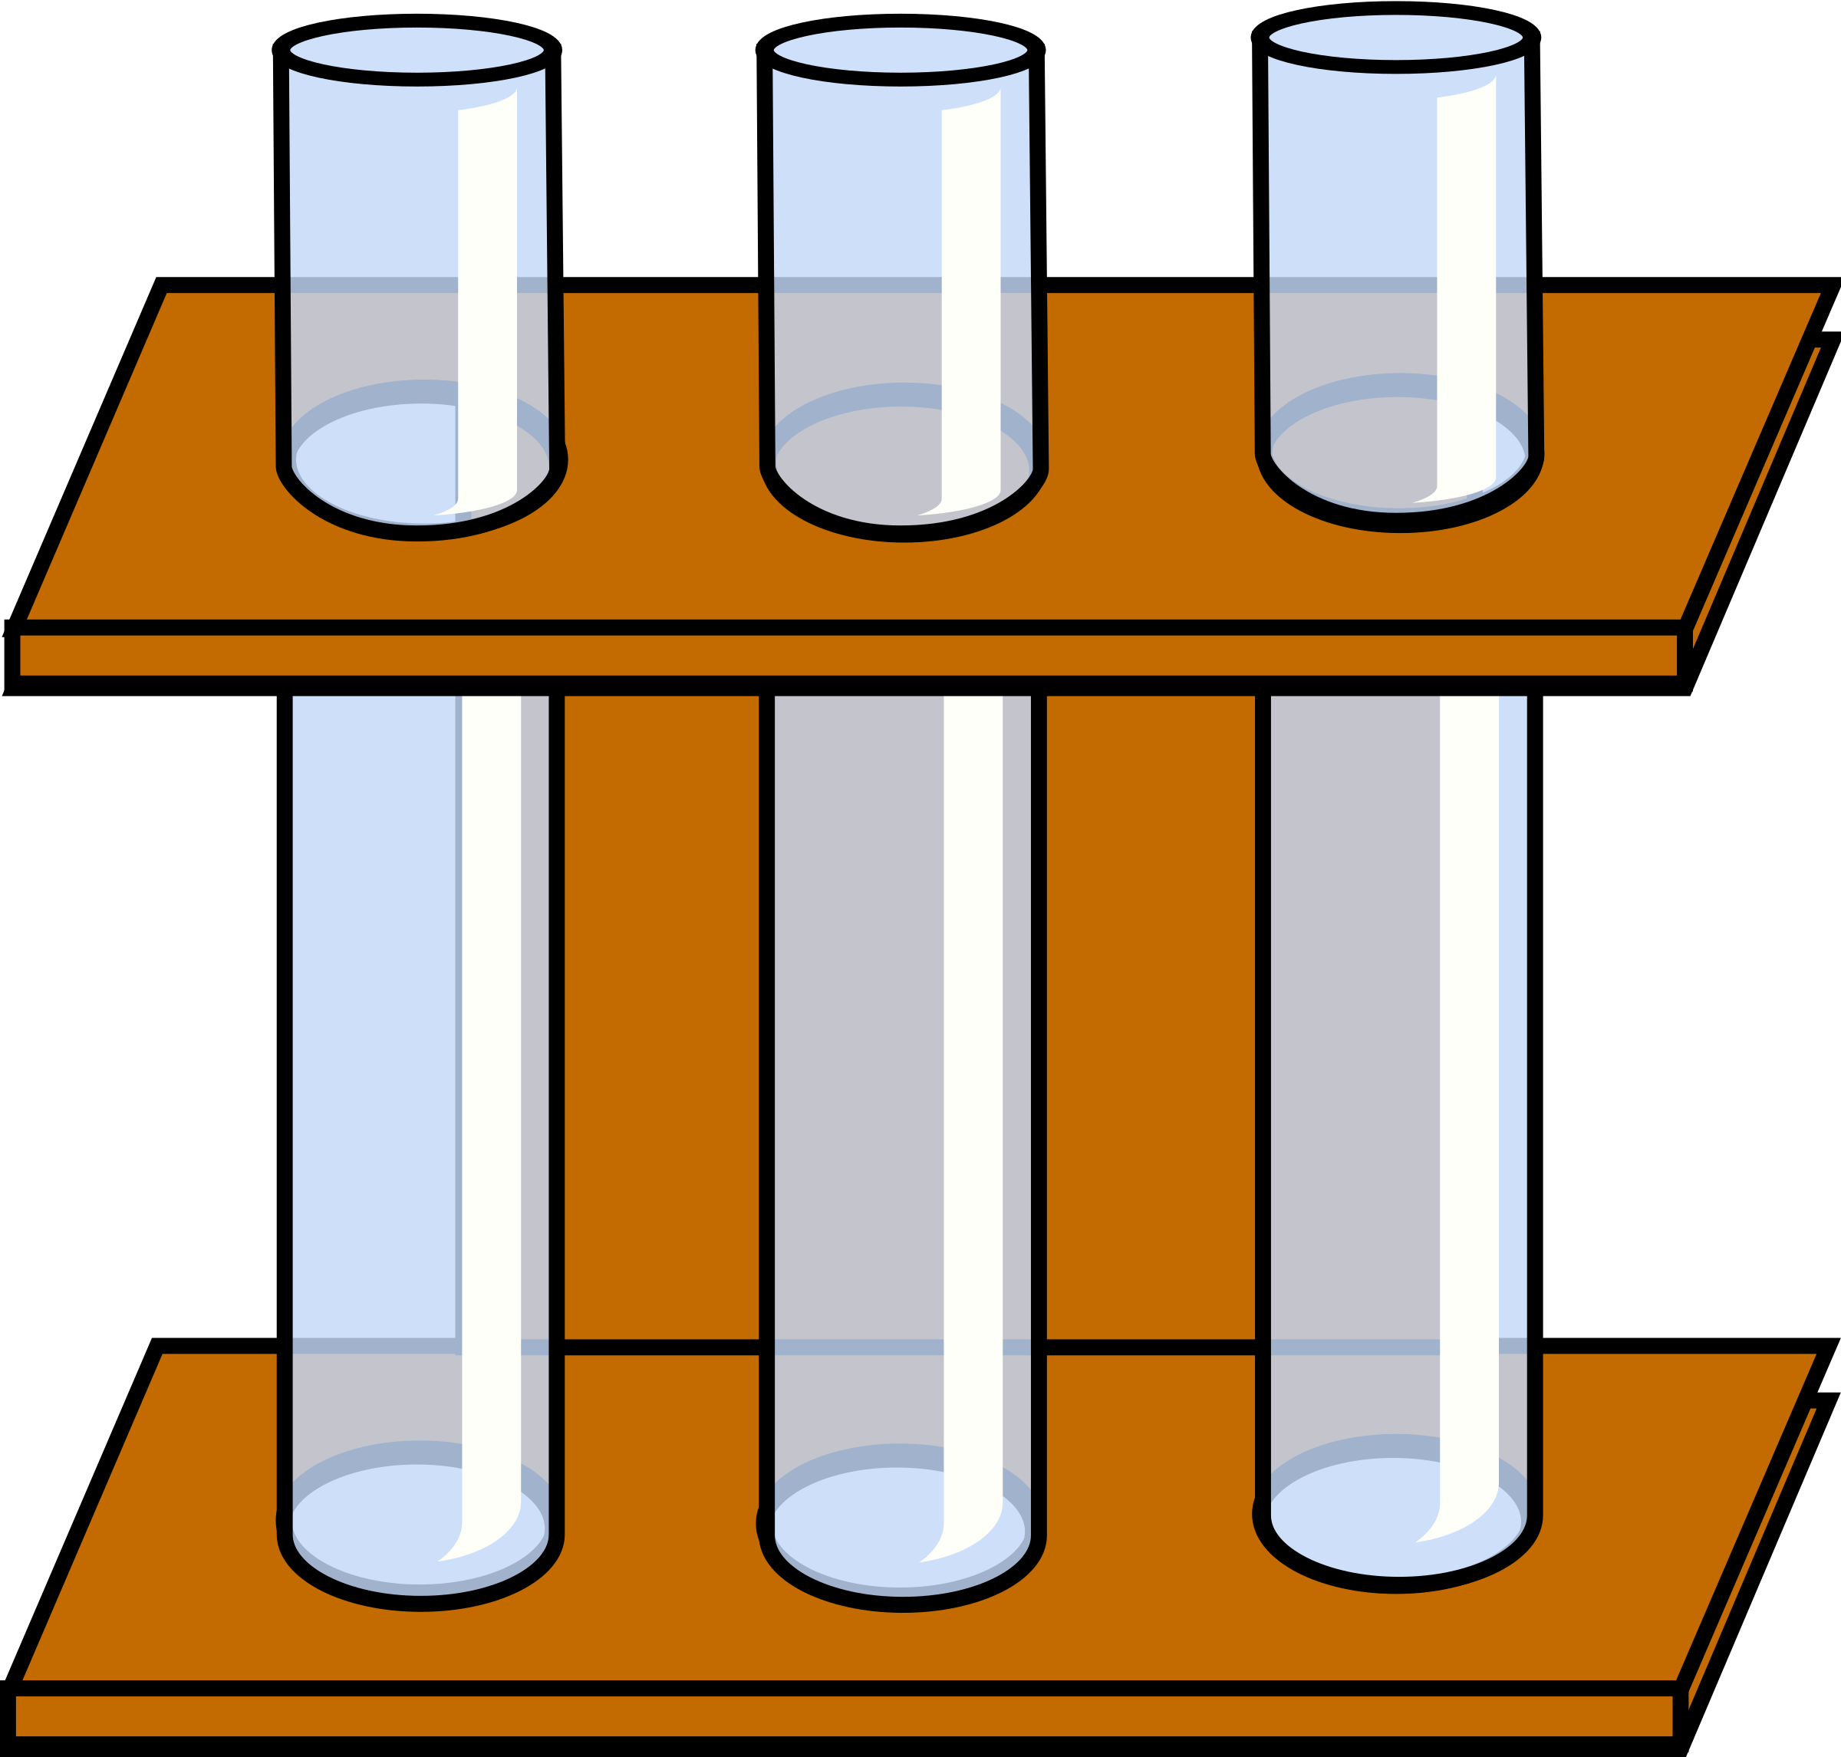
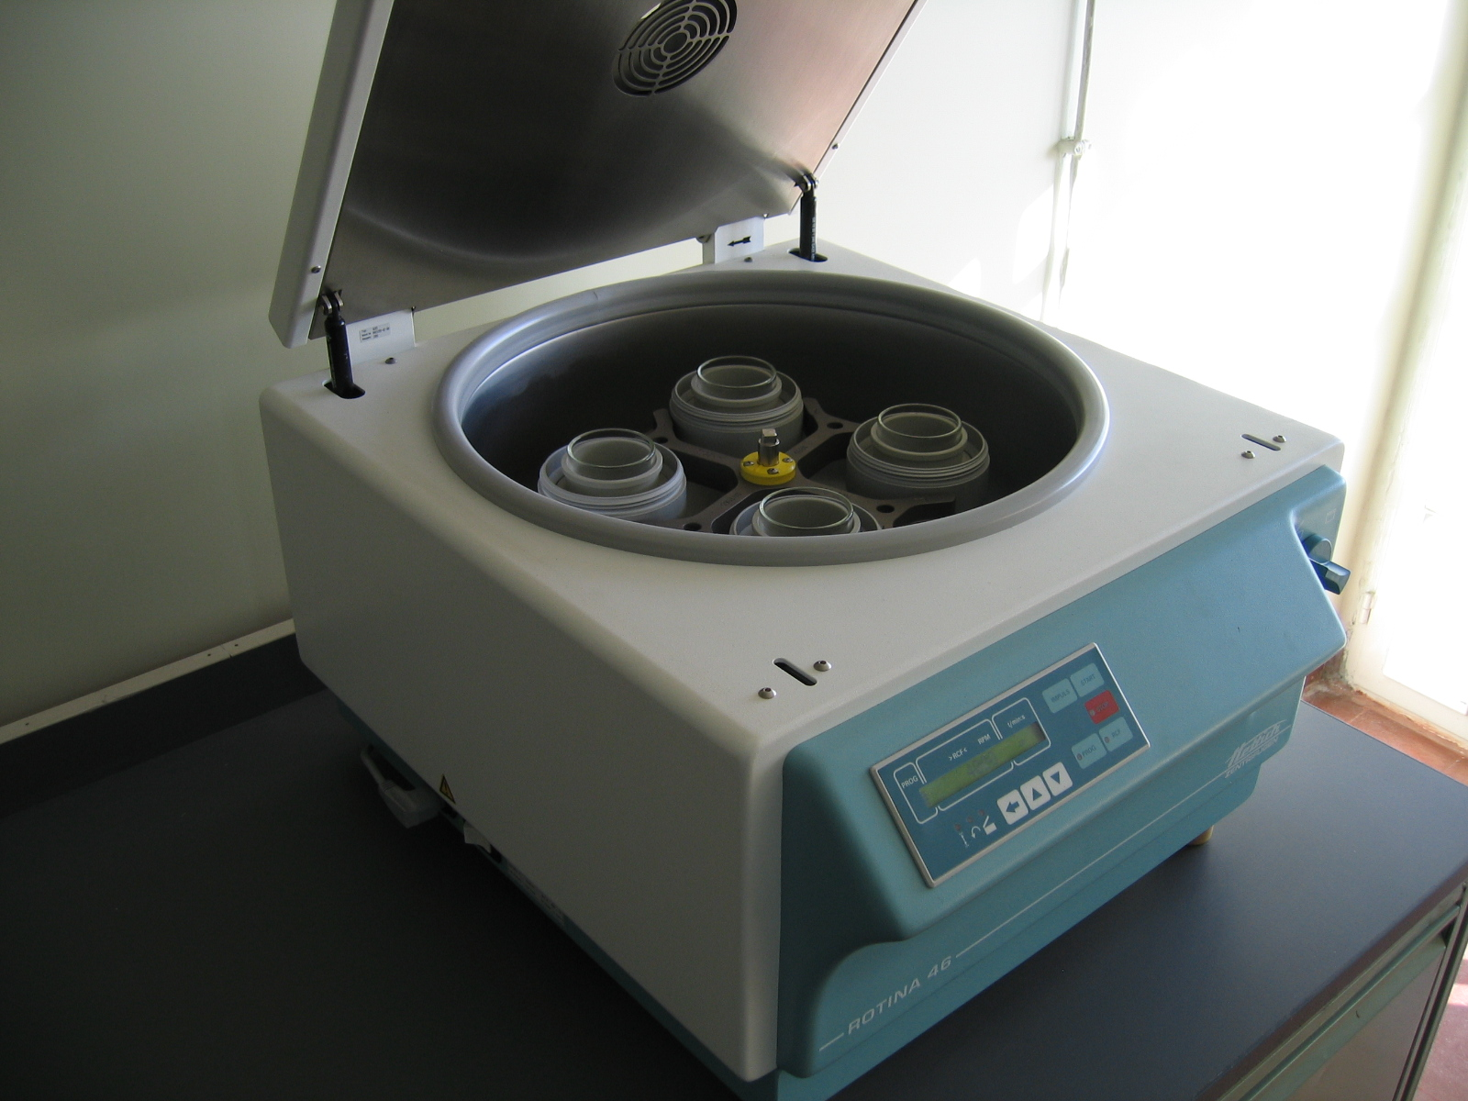

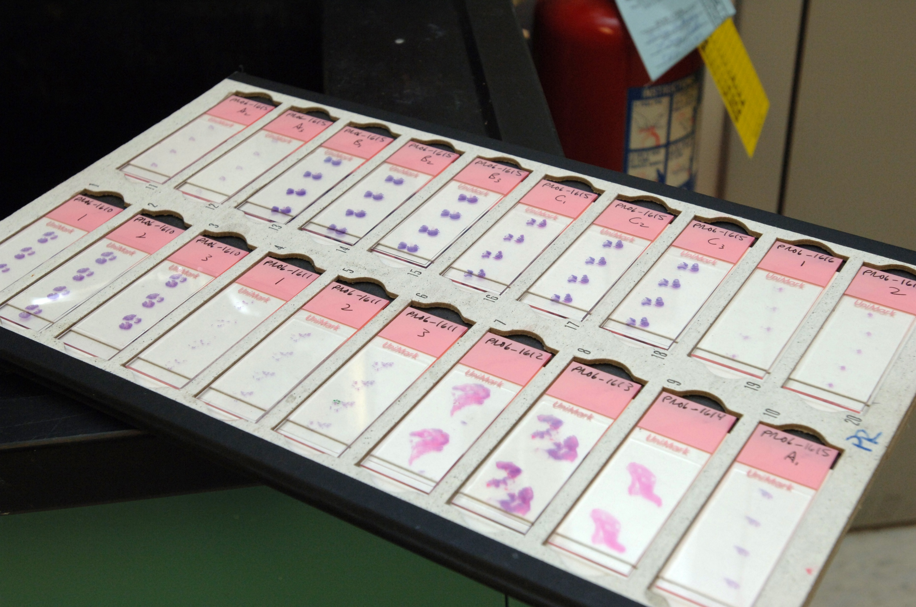
Sample Process One or Two People
Expected cycle time for one load (20 samples): 60 minutes
Load Centrifuge
Unload Centrifuge
Deliver to reader
Build loads
Prepare samples
Centrifuge
samples
Prep & Float samples
Prep Slides
Read and release results
←----------------------------------------30 Minutes--------------------------------------------→
30 minutes
Notes:
Our balanced process required standardizing the process through specific roles, batch sizes, material usage, releasing immediately, and going paperless. Next we needed to determine how to staff to ensure a continued pace throughout the department.

Slide 10
Reduced variation by 81 minutes of 59%
204 Total minutes reduced (Jun 18 – Jun 19)
Change in cycle time (+14) to (-99) minutes

Slide 11
Standardize the Process and Balance the Work

Slide 12
Balance and Key Terms
For samples to move through a process with high velocity, each step needs to be balanced
Key Terms
WIP = Work In Progress: Number of Units being worked on or waiting to be worked on
Cycle Time = Time from the start of a process to the end of the process

Slide 13




A Process: Un-Balanced
Role 1
Role 2
Role 3
Role 4
45 min
Time
25 min
25 min
10 min
Notes:
Change slide

Slide 14
A Process: Un-Balanced
Role 1
Role 2
Role 3
Role 4
45 min
Samples Pile up
Free time!
Time
Samples Pile up
25 min
25 min
10 min
Notes:
Change slide

Slide 15
A Process: Un-Balanced – In 1 Hour
Delivered: 0 / WIP: 8
Role 1
Role 2
Role 3
Role 4
45 min
Time
25 min
25 min
10 min
Notes:
Change slide

Slide 16
A Process: Un-Balanced – In 5 Hours
Delivered: 6 / WIP: 26
Role 1
Role 2
Role 3
Role 4
45 min
Time
25 min
25 min
10 min
Notes:
Change slide

Slide 17
A Process: Un-Balanced – In 8 Hours
Delivered: 9 / WIP: 40
Average CT: 245 min
Role 1
Role 2
Role 3
Role 4
Step 4 Team member waits: 20min/hr
45 min
Time
25 min
25 min
10 min
Notes:
Change slide

Slide 18
Let’s Balance it!

Slide 19
Look Inside…
Role 3
Role 2
3H 5 min
Time
3G 5 min
Role 4
3F 10 min
Role 1
2E 5 min
3E 5 min
4D 10 min
2D 5 min
3D 5 min
2C 5 min
3C 5 min
4C 5 min
1C 3.3 min
2B 5 min
3B 5 min
4B 5 min
1B 3.3 min
2A 5 min
3A 5 min
4A 5 min
1A 3.3 min
Notes:
Run time studies on each step in the process than look to see which steps can be reallocated to another Role.

Slide 20
Look Inside… can we balance by looking at sub-steps?
Role 1
Role 3
Role 2
Time
Role 4
3H 5 min
2C 5 min
3C 5 min
3G 5 min
4D 10 min
2B 5 min
3B 5 min
3F 10 min
2A 5 min
3A 5 min
4C 5 min
1C 3.3 min
2E 5 min
3E 5 min
4B 5 min
1B 3.3 min
3D 5 min
2D 5 min
4A 5 min
1A 3.3 min
Notes:
Run time studies on each step in the process than look to see which steps can be reallocated to another Role.

Slide 21
A Process: More-Balanced – In 8 Hour
Delivered: 13 / WIP: 5
Average CT: 138 min
Role 1
Role 2
Role 3
Role 4
Step 4 Team member waits: 10 min/hr
Time
30 min
25 min
25 min
25 min
Notes:
Change slide

Slide 22
Sample Process
Value Added Steps
Machine Steps
Deliver to hood
Load Centrifuge
Unload Centrifuge
Deliver to reader
Build loads
Prepare samples
Centrifuge
samples
Prep Float
Float samples
Prep Slides
Read and release results
Notes:
When we looked into our process more thoroughly we noticed that 2 steps were machine steps and required no staff interaction during their run and 2 steps were value added and could not be separated into smaller substeps. What remained was non-value added steps that seemed to be disjointed. We felt the best thing was to create 4 distinct roles so our value added steps were no encumbered by non value added steps.

Slide 23
Our Process: Distribute work across 4 Roles
10 min
Role 1
Role 2
Role 3
Role 4
5 min
80 sec
Time
35 sec
15 sec
10 sec

Slide 24
Takt Time

Slide 25
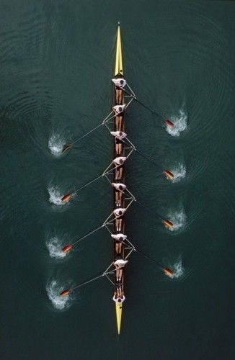
Takt Time = Cadence
Everybody working together
Everybody working at same pace
Work is evenly distributed
Any change in the cadence throws off the boat
Notes:
To keep samples moving and create capacity, need to work on a cadence. Takt is a German word for drum beat or cadence. When we work to a takt time, we are working at a cadence. Working to takt time requires balancing the work and the effort. In O&P, we can’t balance the work itself (swirling takes 30 seconds and can really only be done by one person, reading takes 60 – 90 seconds and can only be done by one person). So we balance effort.

Slide 26
Takt Time Calculation
Available Work Time divided by Demand forecasted for time period
Available Work Time (AWT)
Demand
AWT – time in the shift less any work stoppage
*Breaks are staggered; samples are always being worked on.

Slide 27
Balance to Takt Time… Two Choices
Balance to Takt Time
Further balance process steps so each step produces at the rate (capacity) you require
Balance then Staff to Takt Time
Balance the line as best as currently possible
Then realign resources so production rate achieves Takt Rate

Slide 28
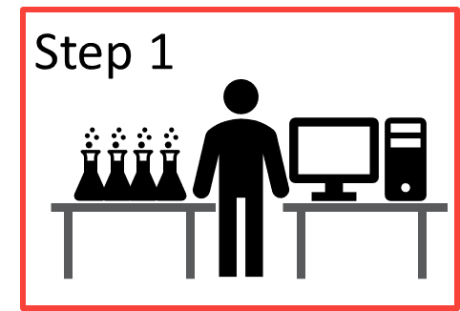
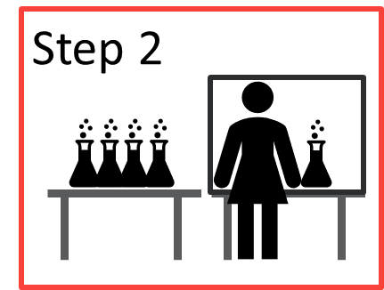
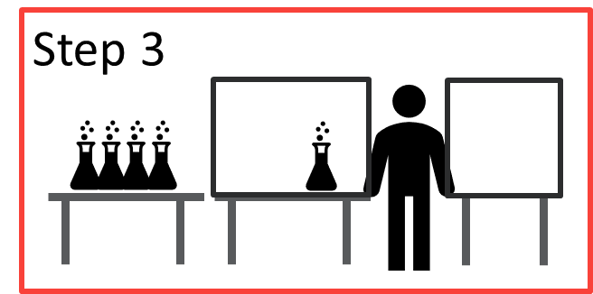
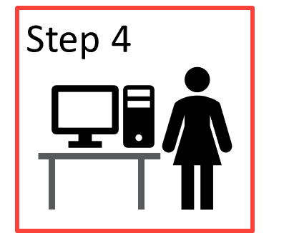
Balancing to Takt Time: Re-balancing to Takt Time
Remember our newly balanced process from earlier…
Time
3H 5 min
2C 5 min
3C 5 min
3G 5 min
4D 10 min
2B 5 min
3B 5 min
3F 10 min
2A 5 min
3A 5 min
4C 5 min
1C 3.3 min
2E 5 min
3E 5 min
4B 5 min
1B 3.3 min
2D 5 min
3D 5 min
4A 5 min
1A 3.3 min

Slide 29
Balancing to Takt Time: Re-balancing to Takt Time
The customer needs 32 daily
Available Time = 8 hours
Takt Time: 8 hours/32 samples = 15 minutes/sample
Time
3H 5 min
2C 5 min
3C 5 min
3G 5 min
4D 10 min
15 min
2B 5 min
3B 5 min
3F 10 min
2A 5 min
3A 5 min
4C 5 min
1C 3.3 min
2E 5 min
3E 5 min
4B 5 min
1B 3.3 min
2D 5 min
3D 5 min
4A 5 min
1A 3.3 min

Slide 30
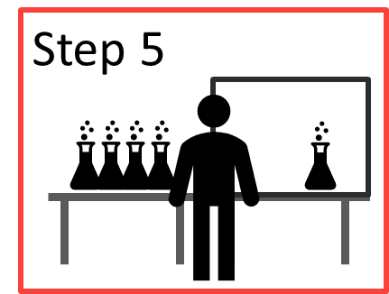



Re-balancing to Takt Time – 8 hours
Delivered: 26 / WIP: 7
Average CT: 105 min
Time
15 min
2A 5 min
2D5 min
3B 5 min
3E 5 min
3G 5 min
4B 5 min
4D 10 min
1C 3.3 m
2C5 min
3A 5 min
3D 5 min
3F 10 min
4A 5 min
1B 3.3 min
2E 5 min
3C 5 min
3H 5 min
4C 5 min
2B 5 min
1A 3.3 min
Notes:
One way to balance to takt time is breaking down into even more workstations

Slide 31
Our Process: Still unbalanced - Our takt time is ~ 10 sec/sample
10 min
Role 1
Role 2
Role 3
Role 4
5 min
80 sec
Time
35 sec
15 sec
10 sec

Slide 32
Balance the work groups to Takt Time
Need multiple stations (toll booths) to meet takt
If Process A cycle time = 30 seconds and takt time = 10 seconds per sample
… will need 3 stations (30/10) doing same work to meet takt.
Every 30 seconds, 3 samples are processed
Process

Slide 33
Balancing to Takt Time: Tollgates
Cycle Times:
Role 1: 15 seconds
Role 2: 35 seconds
Role 3: 10 seconds
Role 4: 80 seconds
Tollgates needed:
Role 1: 1.5 people
Role 2: 3.5 people
Role 3: 1 people
Role 4: 8 people
Tollgates:
Cycle time/Takt Time

Slide 34
Remember our Process: Balanced
15 sec
35 sec
10 seconds
80 sec
Role 1
Role 2
Role 3
Role 4
10 seconds
Role 1 10 sec
Role 2
10 sec
Role 2
10 sec
Role 2 10 sec
Role 3 10 sec
Role 4 10 sec
Role 4 10 sec
Role 4 10 sec
Role 4 10 sec
Role 4 10 sec
Time
…
Role 1 5 sec
Role 2 5 sec
1.5
3.5
1
8
Notes:
After balancing to takt we created

Slide 35
Rapid Improvement Event and beyond

Slide 36
In the lab….
Project team members – lab personnel and leadership
Reviewed current state; identified waste;
Defined ideal state
Developed future state
Notes:
Some changes include reducing batch sizes, creating Kanbans, reducing touch points

Slide 37
Coaching
Lean Leader 2 weeks a month in the lab
walking alongside supervisor and team
setting up Kanbans for Role 2 and 4
adjusting layouts
Once process and roles in place, taught supervisors to watch flow and adjust staffing; encouraged Gemba walks and Ohno circles

Slide 38
Learnings
Level loading inputs to the lab helped successes
Addressing layout to aid flow was key to reducing transportation waste
RIEs should occur at same time, not staggered
Standardize, balance work, then balance to takt time
Improved process times in the department as shown on our CFD but some of our increases are due to overprocessing in upstream department

Slide 39
Learnings
CANNOT NEGLECT CULTURE
Leaders needed to be actively involved from the beginning
Collaboration calls sharing best practices should be started near the beginning of the change
Go see
Integrate Gemba boards
Communicate the Why

Slide 40


